Slide 1



Ground Control Station for Cansat
Presented by: Hemanth M Reg. No.: 3SU22BC003 Course: BCA VI Semester University: Srinivas University Internal Guide: Dr Manjula C M Prasad Designation: Professor and Head Academics
External Guide: Ashwin Reddy
Designation: Research Scientist
Company: ITCA

Slide 2








Slide 3



1
1.1 Project Description
CanSats, or Can-sized Satellites, are miniature space-bound systems designed for
hands-on educational and research applications in aerospace and telemetry.
This project presents a smart Ground Control Station that enables:
Real-time telemetry monitoring of CanSats
Secure user access with Two-Factor Authentication
Live data visualization through charts and maps
Historical telemetry filtering and analysis
The system is built to simulate mission-like scenarios, delivering an interactive and secure environment for operators, analysts, and educators.
.

Slide 4
1.2 Objectives
2
Secure, real-time telemetry monitoring.
Role-based user authentication & management.
Real-time data visualization (charts + map).
Historical telemetry filtering & export.
TOTP-based 2FA & password recovery via OTP.

Slide 5
Scope of the Project
3
Real-time telemetry monitoring
Secure user authentication
Role-based access control
Live data visualization
Telemetry data filtering
User and session management
scalability and modularity

Slide 6
Literature Review
4
Paper 1 Title: “Design and Implementation of a Low-Cost Real-Time Ground Control System for Educational CanSat Missions” Authors: A. Sharma et al. Published In: International Journal of Aerospace Engineering, 2021 Insight: This paper introduces a cost-effective GCS using GPS and RF modules, with real-time plotting and data logging built using Python and Tkinter, suitable for academic CanSat applications.

Slide 7
Literature Review
5
Paper 2 Title: “SDR-Based Robust Telemetry Framework for Miniaturized Satellites” Authors: X. Zhou et al. Published In: IEEE Transactions on Aerospace and Electronic Systems, 2022 Insight: Proposes a telemetry system based on Software Defined Radio (SDR), achieving better signal-to-noise ratio and adaptability to environmental noise—ideal for improving CubeSat and CanSat data links.

Slide 8




Existing System
6
Limited Real-Time Interactivity
No User Authentication or Role Management
No Historical Data Visualization
Poor Modularity and Extensibility
Absence of Alerting, Filtering, and Analytics

Slide 9
Proposed System
7
Real-time dashboard using Socket.io.
Secure login with JWT + TOTP.
Role-based user management (Admin, Viewer).
Map and charts integration for telemetry insights.
Live data visualization with graphical charts and dashboards.
Automated data logging and analysis for mission efficiency.

Slide 10
Problem definition: Challenge
8
Manual data collection and analysis is slow and inefficient
Lack of a centralized system for real-time telemetry reception via a serial port
Unreliable data logging, leading to potential mission-critical data loss
No streamlined graphical interface for visualizing live telemetry data

Slide 11
HARDWARE AND SOFTWARE REQUIREMENTS

Slide 12
Hardware Requirements:
9
Processor: Intel Core i5, 8th Gen or higher
RAM: 8 GB (minimum), 16 GB recommended
Storage: 25 GB SSD minimum
Internet Bandwidth: Stable connection with > 20 Mbps
Operating System: Windows 10 or higher .

Slide 13
Software Requirements:
10
Node.js: Version 18.x (Backend server environment)
Express.js: Version 4.x (REST API backend framework)
PostgreSQL: Version 14.x (Relational database)
Sequelize ORM: For PostgreSQL database modeling and queries
Socket.IO: Real-time communication (WebSocket integration)
React.js: Version 18.x (Frontend framework)

Slide 14
Software Requirements:
11
Chart.js: For live telemetry data charting
Recharts: For responsive and interactive telemetry graphs
HTML/ CSS3/ Bootstrap: UI design and layout styling
Bcrypt / jsonwebtoken: For password hashing and secure user authentication
Nodemailer: For sending OTP-based reset password emails

Slide 15

SOFTWARE REQUIREMENTS SPECIFICATION

Slide 16
Users
12
Admin
Manage users (create, update, delete)
Access all telemetry data and system settings
Viewer
Read-only access to telemetry data
Can view charts, maps, and filtered data
No access to user management or settings

Slide 17
Functional Requirements
13
User authentication via email, password, and TOTP-based 2FA
Role-based dashboard with access control for Admin, Viewer
Real-time telemetry stream using Socket.IO (every 5 seconds)
Data visualization: line charts, gauges, maps (React + Recharts + Leaflet)
Telemetry filtering by date/time range and CSV export
Password reset via OTP email verification
User session logging and logout functionality
Dashboard features: dark mode toggle, pagination, sorting, and search.

Slide 18
Non-Functional Requirements
14
Security: JWT-based authentication, bcrypt password hashing, TOTP 2FA
Performance: Low-latency real-time updates (<2s); backend optimized for concurrent users
Usability: Clean, responsive single-page UI with React.js
Scalability: Modular backend (Express.js) and database structure (PostgreSQL)
Reliability: Robust error handling and real-time data fallback
Maintainability: Clearly structured codebase using MVC and REST principles
Portability: Platform-independent; runs in any modern browser

Slide 19
SYSTEM DESIGN

Slide 20
Context diagram (DFD Level-0)
15
User (Admin / Viewer): Interacts via React-based frontend for login, signup, dashboard view.
React Frontend SPA (Single Page App): Sends/receives data using JWT-secured API and WebSocket.
Ground Control Station System (Backend): Handles authentication, telemetry streaming, user/role logic.
Telemetry Source: Continuously streams live telemetry data to the backend.
PostgreSQL Database: Stores telemetry data, user info, login history, OTPs.
Email Server (Nodemailer): Sends OTP for password reset and authentication via email.

Slide 21
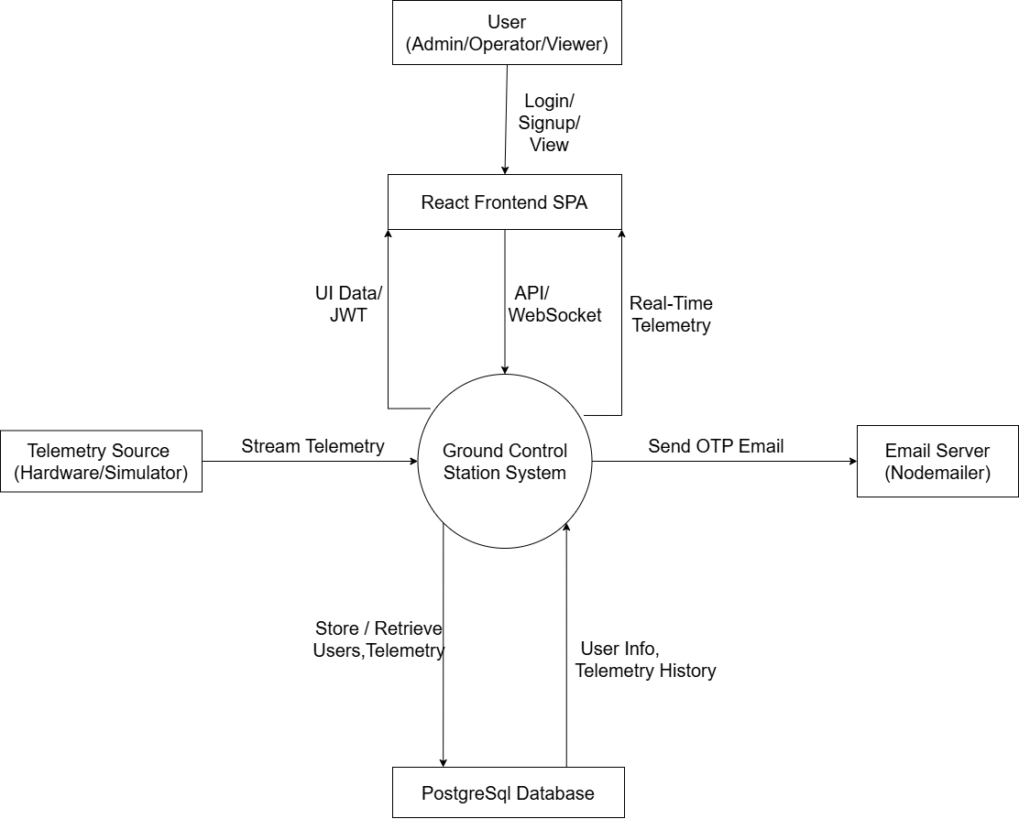
Context diagram (DFD Level-0)
16

Slide 22
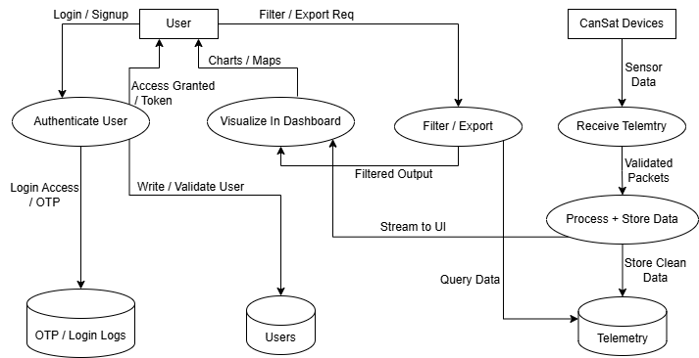
Data Flow Diagram (DFD) Level 1
17

Slide 23
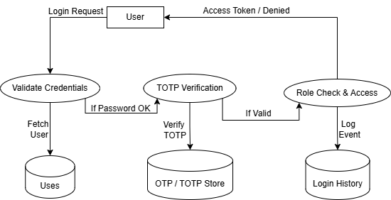
Data Flow Diagram (DFD) Level 2 User Authentication & Role Management
18

Slide 24
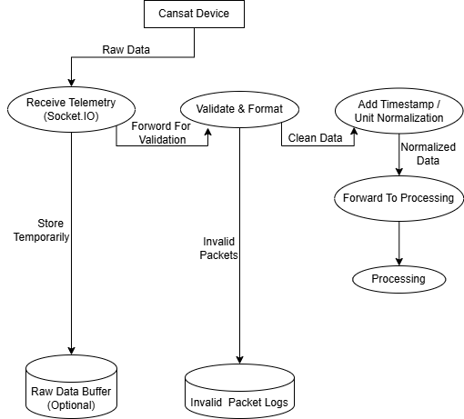
Data Flow Diagram (DFD) Level 2 CanSat Telemetry Acquisition
19

Slide 25
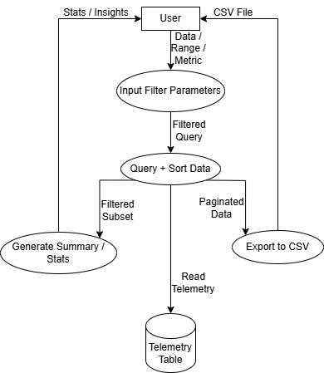
Data Flow Diagram (DFD) Level 2 Data Filtering & Analysis
20

Slide 26
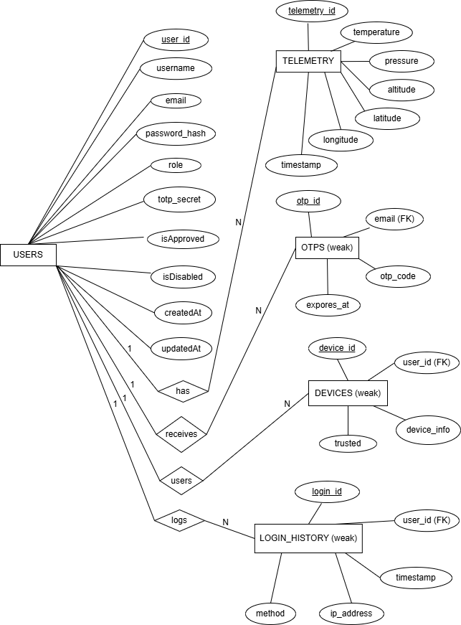
Entity Relationship (ER) Diagram
21

Slide 27
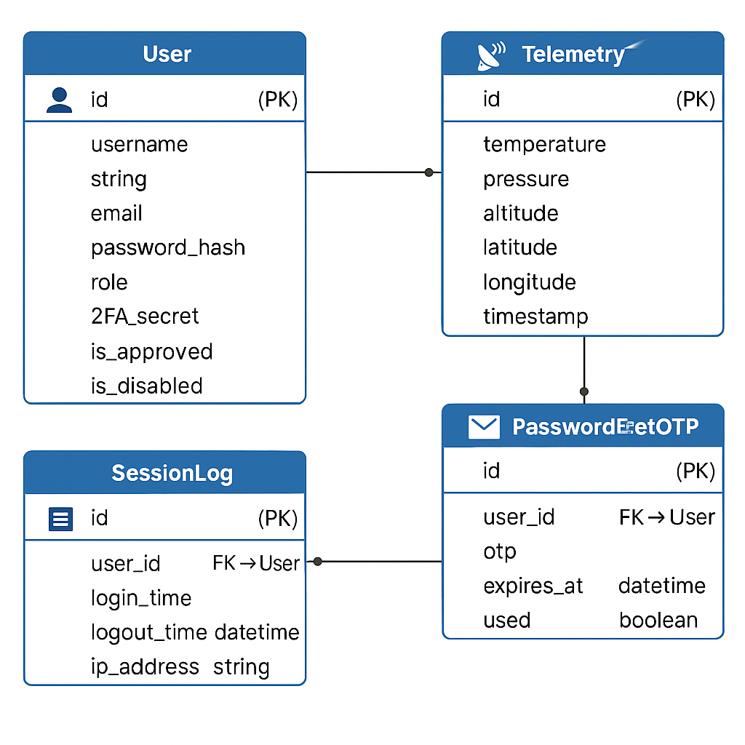
Relationship Schema
22

Slide 28
Database Table
23
1. Users Table
Column Name | Data Type | Constraints | Description
user_id | Integer | Primary Key, Auto-increment | Unique ID for each registered user
Username | String | Unique, Not Null | Display name of the user
Email | String | Unique, Not Null | Registered email address
password_hash | String | Not Null | Hashed password using bcrypt
Role | String | Default: 'user' | Role of the user (admin/user)
totp_secret | String | Nullable | TOTP secret for 2FA
isApproved | Boolean | Default: false | Indicates if the user is approved
isDisabled | Boolean | Default: false | Indicates if the user is disabled / banned
createdAt | DateTime | Default: Current timestamp | Account creation timestamp
updatedAt | DateTime | Auto-updated on modification | Last updated timestamp of the user record

Slide 29
24
2. Telemetry Table
Column Name | Data Type | Constraints | Description
telemetry_id | Integer | Primary Key, Auto-increment | Unique telemetry entry ID
Temperature | Float | Not Null | Temperature reading from CanSat
Pressure | Float | Not Null | Pressure reading
Altitude | Float | Not Null | Altitude data from sensor
Latitude | Float | Not Null | Latitude coordinate
Longitude | Float | Not Null | Longitude coordinate
Timestamp | DateTime | Not Null | Time of data recording

Slide 30
25
3. Otps Table
Column Name | Data Type | Constraints | Description
otp_id | Integer | Primary Key, Auto-increment | Unique OTP record ID
email | String | Not Null | Associated user email
otp_code | String | Not Null | One-time password sent to email
expires_at | DateTime | Not Null | Expiration timestamp of OTP

Slide 31
26
4. Devices Table
Column Name | Data Type | Constraints | Description
device_id | Integer | Primary Key, Auto-increment | Unique ID for each trusted device
user_id | Integer | Foreign Key (users.id) | Associated user ID
device_info | String | Not Null | Device metadata
trusted | Boolean | Default: false | Whether the device is trusted

Slide 32
27
5. Login_History Table
Column Name | Data Type | Constraints | Description
device_id | Integer | Primary Key, Auto-increment | Unique ID for each trusted device
user_id | Integer | Foreign Key (users.id) | Associated user ID
device_info | String | Not Null | Device metadata
trusted | Boolean | Default: false | Whether the device is trusted

Slide 33
DETAILED DESIGN

Slide 34
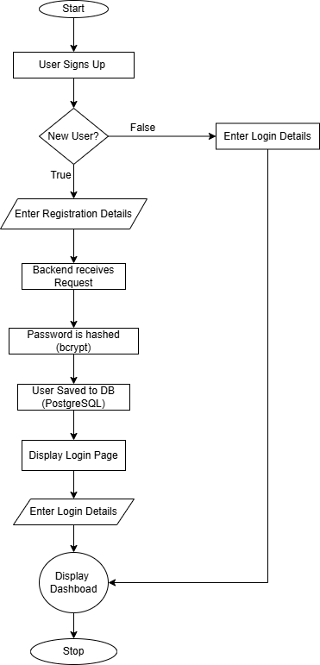
Register Flow
28

Slide 35
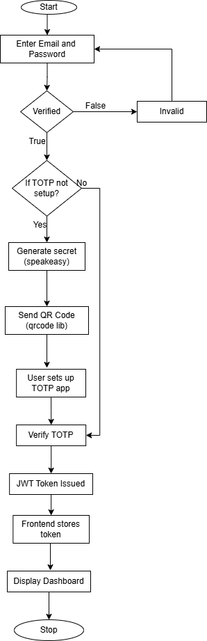
Login Flow
29

Slide 36
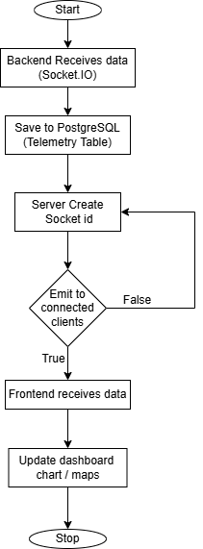
CanSat Data Acquisition
30

Slide 37
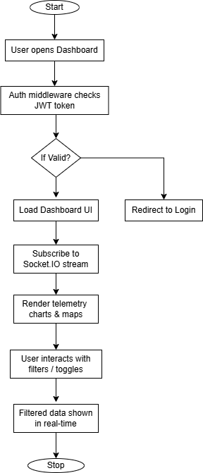
Data Processing & Storage
31
False
True

Slide 38
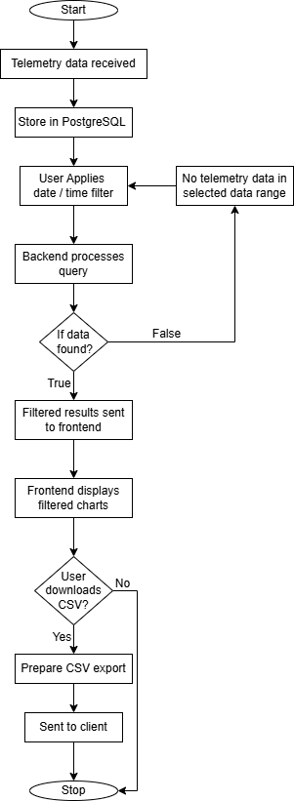
Data Filtering & Analysis
32

Slide 39
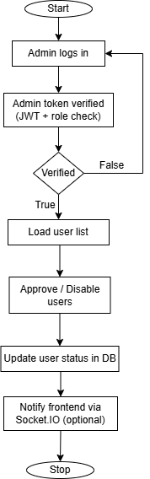
Admin Flow
33

Slide 40
SOFTWARE TESTING

Slide 41
Test Cases
34
Test Case ID | Feature | Description | Steps | Expected Result
TC001 | User Registration | Register a new user with valid data | Submit registration form with valid email, password, and role | User is registered successfully and receives token
TC002 | User Registration | Register with existing email | Submit registration form with an email already in use | Error message "User already exists" is returned
TC003 | User Login | Login with valid credentials | Submit login form with correct email and password | User is logged in and receives JWT token
TC004 | User Login | Login with invalid credentials | Submit login form with incorrect password | Error message "Invalid credentials" is returned
TC005 | Telemetry Data Filter | Filter telemetry data by date range | Call /api/telemetry/filter with valid start and end dates and valid token | Returns filtered telemetry data array

Slide 42
Test Cases
35
Test Case ID | Feature | Description | Steps | Expected Result
TC006 | Admin - Get Users | Admin retrieves all users | Call /api/admin/users with admin token | Returns list of all users
TC007 | Admin - Update User | Admin updates user details | Call /api/admin/users/:id with updated user data and admin token | User details are updated successfully
TC010 | Admin - Delete User | Admin deletes a user | Call /api/admin/users/:id with DELETE method and admin token | User is deleted successfully
TC011 | Frontend - Dashboard | Dashboard page renders correctly | Navigate to Dashboard page | Dashboard header and charts are displayed
TC012 | Frontend - Signup | Signup page renders and accepts input | Navigate to Signup page and fill form | Signup form fields are present and accept input

Slide 43
USER INTERFACE

Slide 44
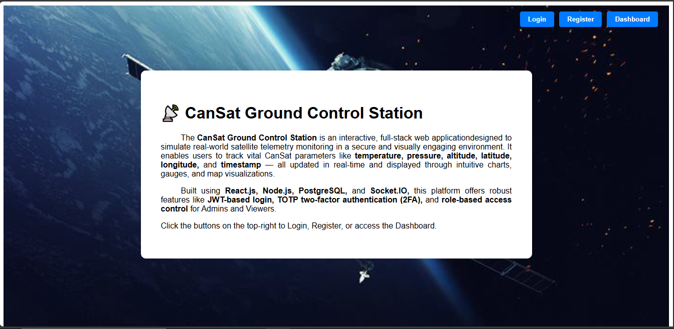
36
About Page

Slide 45
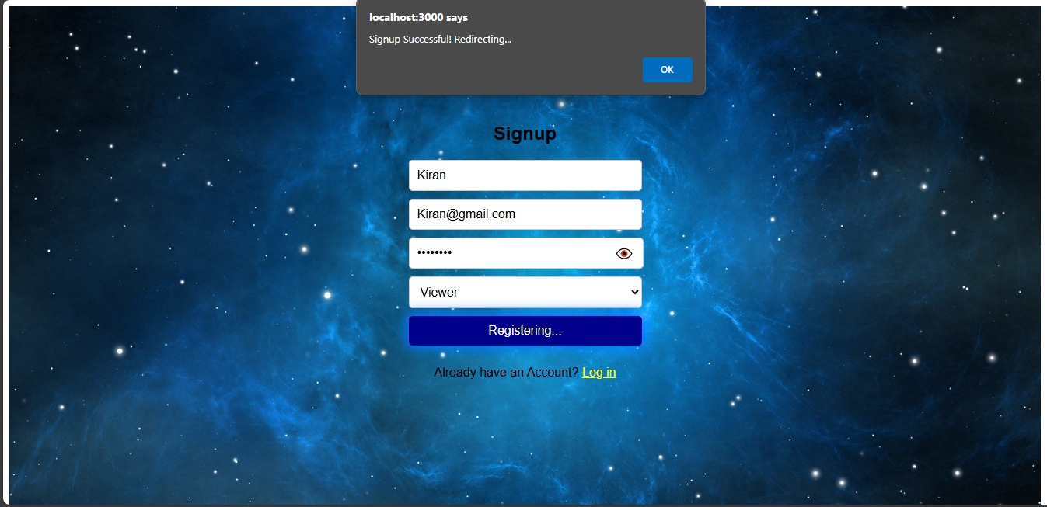
37
Signup Page

Slide 46
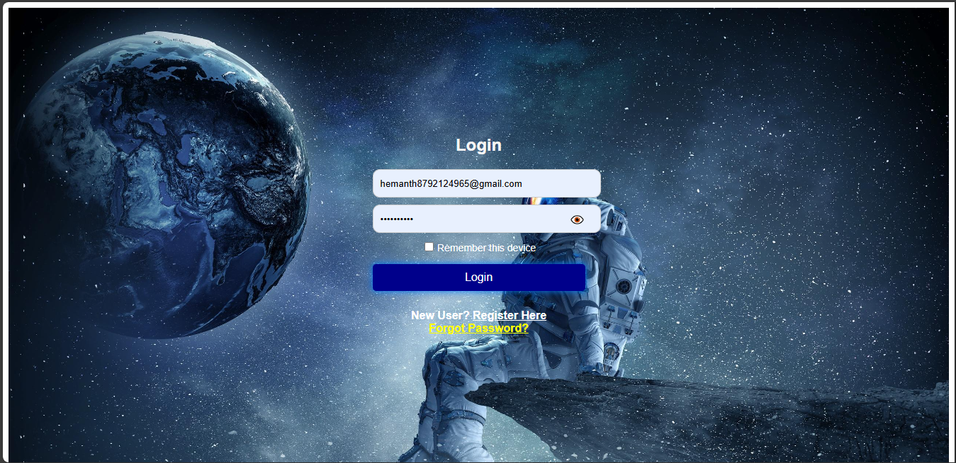
38
Login Page

Slide 47
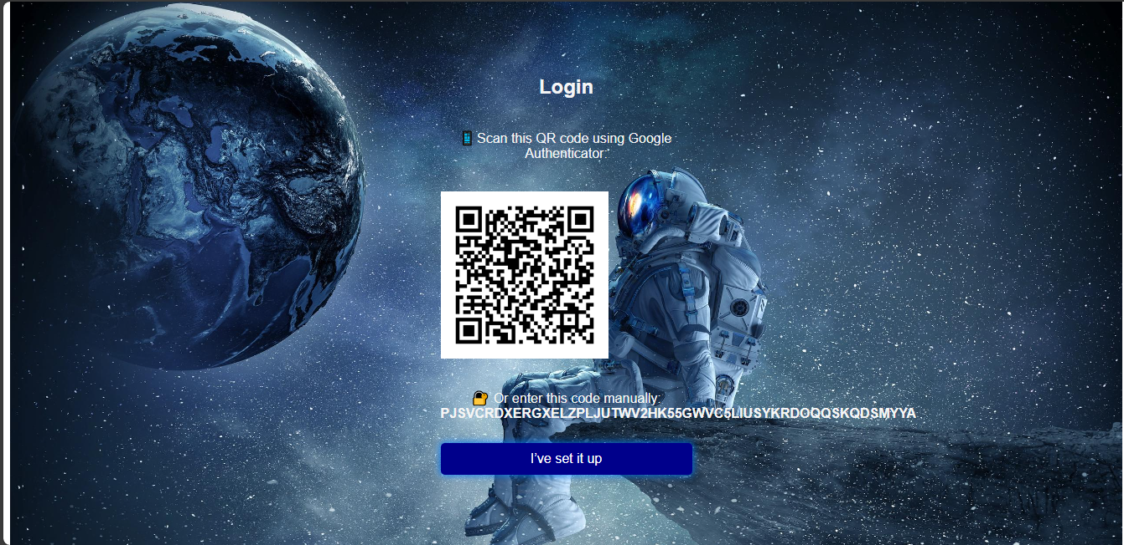
39
Totp_Setup

Slide 48
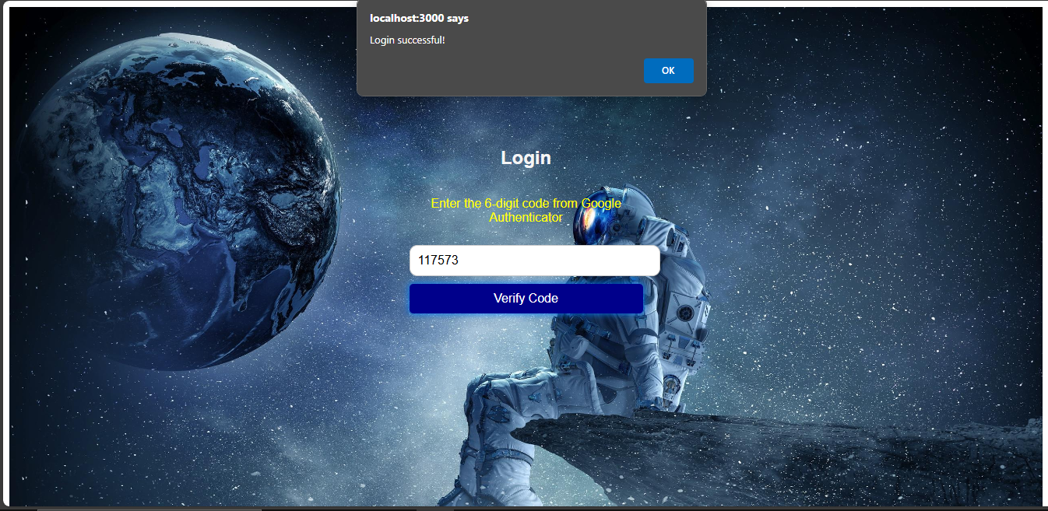
40
Totp Page

Slide 49
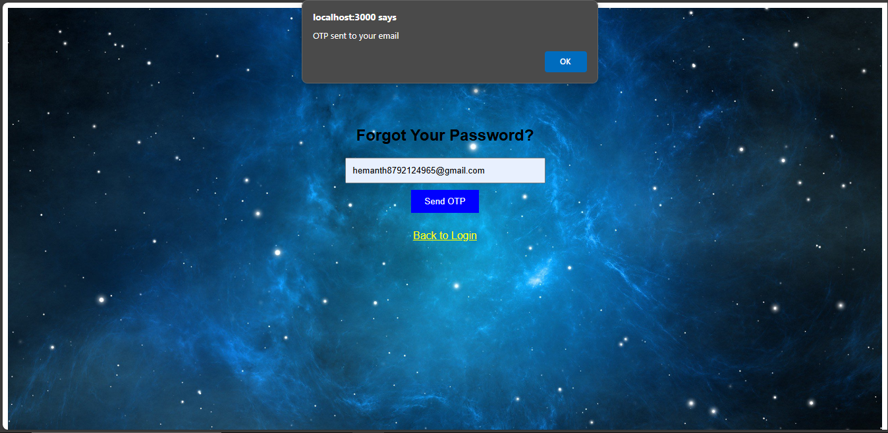
41
Forgot Password Page
Email

Slide 50
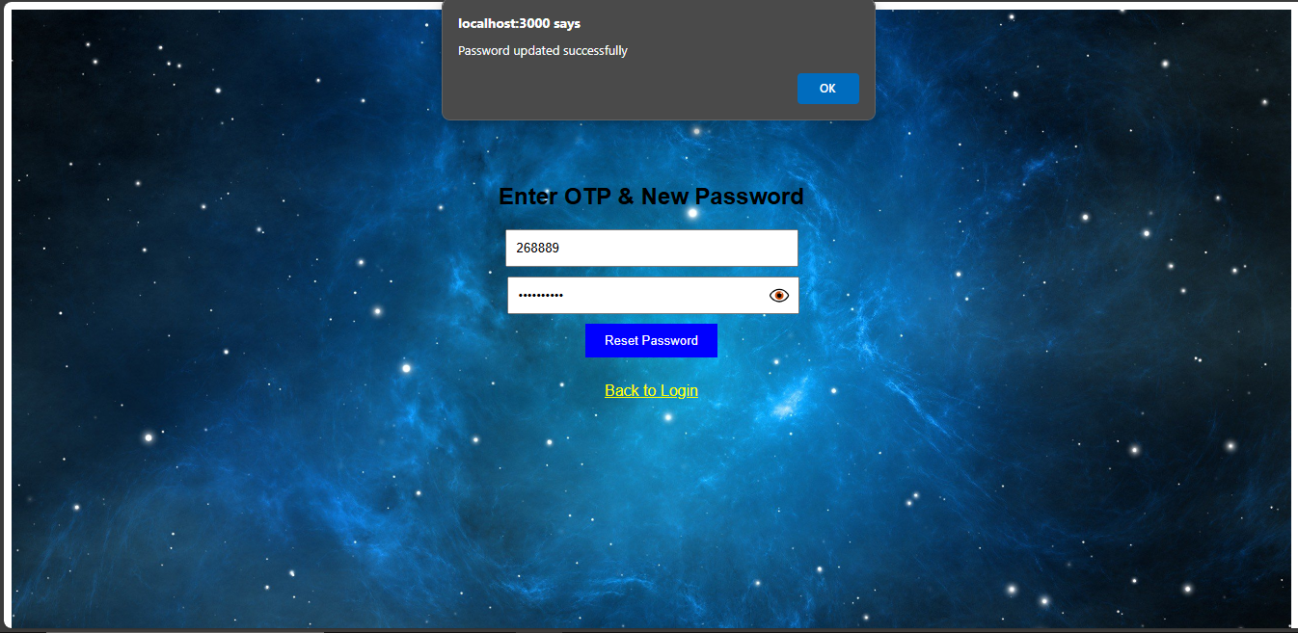
42
Otp & New Password

Slide 51
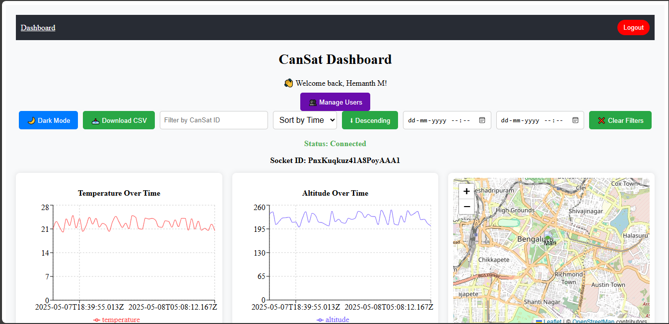
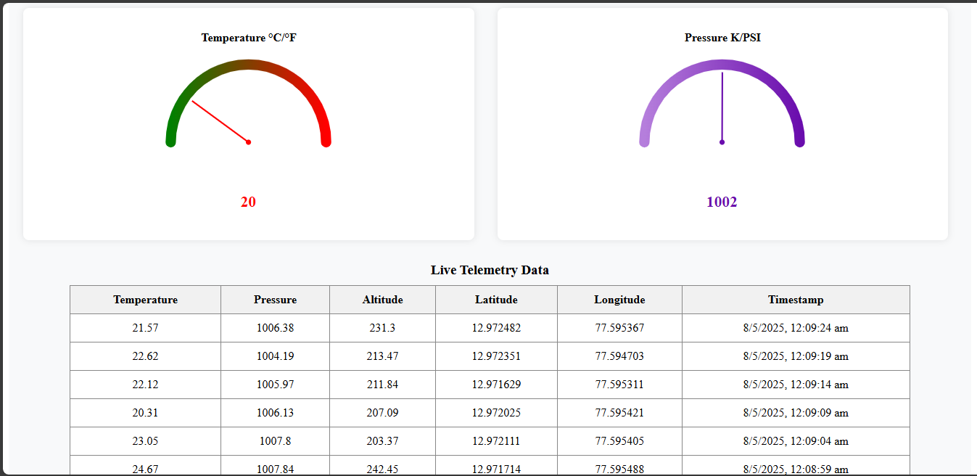
43
Dashboard Page

Slide 52
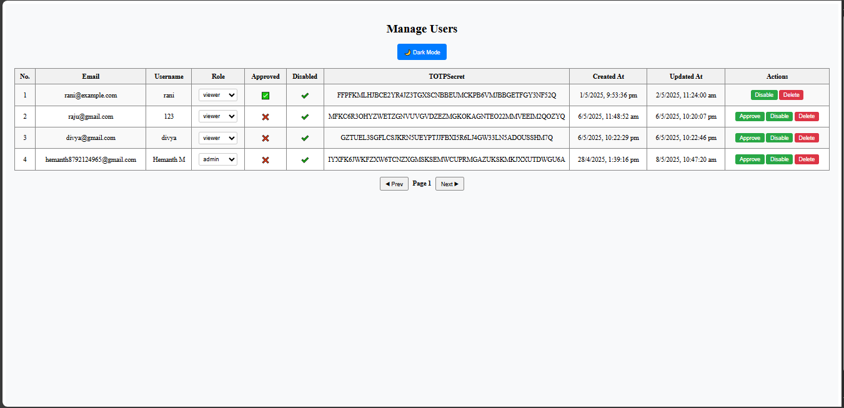
44
Manage User Page

Slide 53
10. Conclusion
45
The “GROUND Control Station for CanSats” works by receiving real-time telemetry data from a CanSat via a simulated or actual data feed. This data—such as temperature, pressure, altitude, latitude, longitude, and timestamps—is streamed to the frontend using Socket.IO. The React-based user interface displays this data in live charts and tables, allowing users to filter by date and time, sort values, and download telemetry as CSV. User authentication is managed through JWT tokens, with optional two-factor authentication using Google Authenticator. All telemetry and user data is stored securely in a PostgreSQL database, managed via a Node.js and Express backend.

Slide 54
11. Future Enhancements
46
A potential future enhancement could be the integration of voice-command support using Web Speech API, allowing operators to interact with the Ground Control Station through spoken commands. This hands-free control can enhance accessibility, speed up operations during critical missions, and provide a modern, user-friendly interface for managing CanSat telemetry and system functions.

Slide 55
Appendix A: Bibliography
47
A. Sharma, R. Gupta, and N. Kumar, “Development of a Low-Cost Ground Control Station for CanSat Telemetry Using Python,” International Journal of Electronics and Communication Engineering, vol. 14, no. 3, pp. 120–125, 2021.
X. Zhou and H. Li, “A Software-Defined Radio Framework for Satellite Telemetry Systems,” IEEE Transactions on Aerospace and Electronic Systems, vol. 58, no. 2, pp. 78–85, 2022.
M. Kaya and S. Öztürk, “Design and Implementation of Real-Time Data Visualization in CanSat Ground Stations,” Proc. of the National Space Research Symposium, 2020, pp. 98–104
IEEE Aerospace Conference, “Next-Gen Ground Control with Node.js and React.js for CubeSat Telemetry,” IEEE Aerospace Conf. Proc., 2023.
P. Lee,J. Zhang, and R. Thomas, “Adopting WebSocket and RESTful APIs for Lightweight IoT-Based Telemetry,” Journal of Embedded Systems and Applications, vol. 19, no. 1, pp. 33–40, 2023

Slide 56
Thank you
ITCA-SUSAT-Team

